Slide 1

Week 3: October 9
GRAB SOME ICED COFFEE PEOPLE!
Recap & Reminders
Dr. Bettina Casad
- Curriculum Vitae
- Statement of Purpose

Slide 2
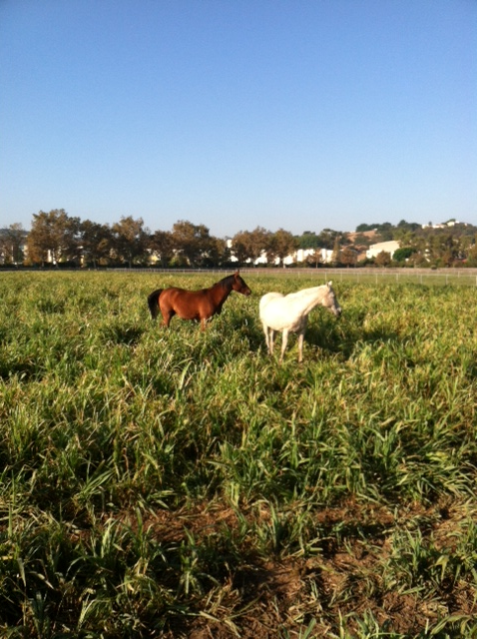
Matt’s Run
Good times!!
3.5 miles

Slide 3
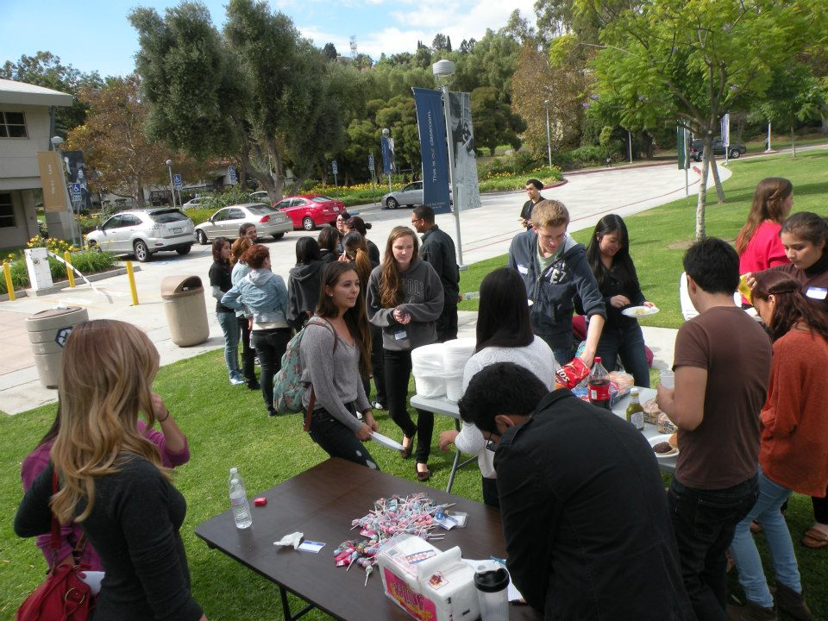
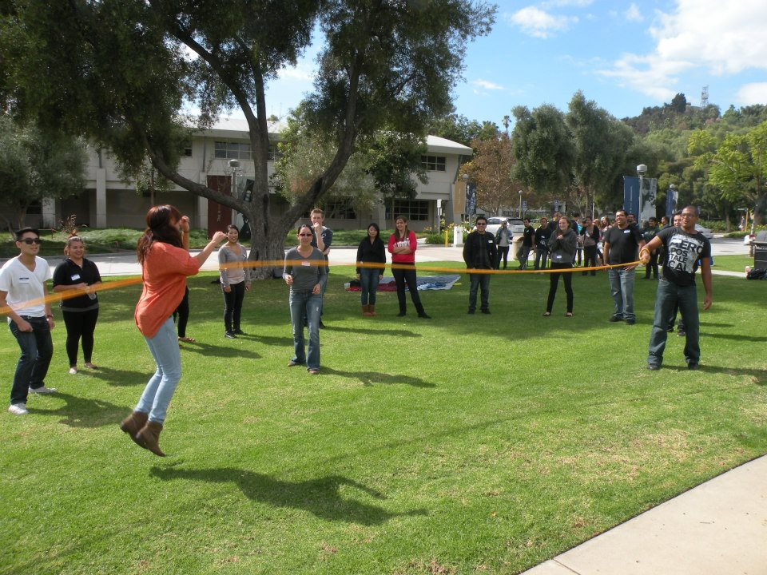
Welcome Back Social!

Slide 4
Upcoming community service events
Outreach Nation – Oct. 20th in Rancho Cucamungo
Kid Care – Oct.27th in Montclair
Helping Hands Ministry – Nov. 4th in Pomona
* 3 POINTS TOWARDS INTERNATIONAL MEMBERSHIP!*
(3 for each event, 9 possible point)

Slide 5
Psi Chi Study Hours
*Mondays from 4p.m. – 6p.m.*
  4th Floor - - 4823 [tentatively]
*Thursdays from 10a.m. – 11a.m.*
  4th Floor - - 4823 [tentatively]
_Study for the GRE
_For psychology classes where other members might be available to help
_Any general studying!

Slide 6
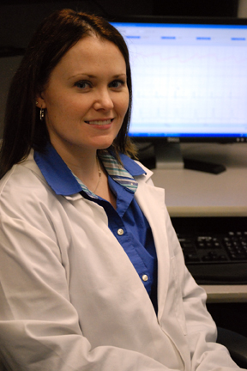
Introducing Dr. Casad!

