Slide 1
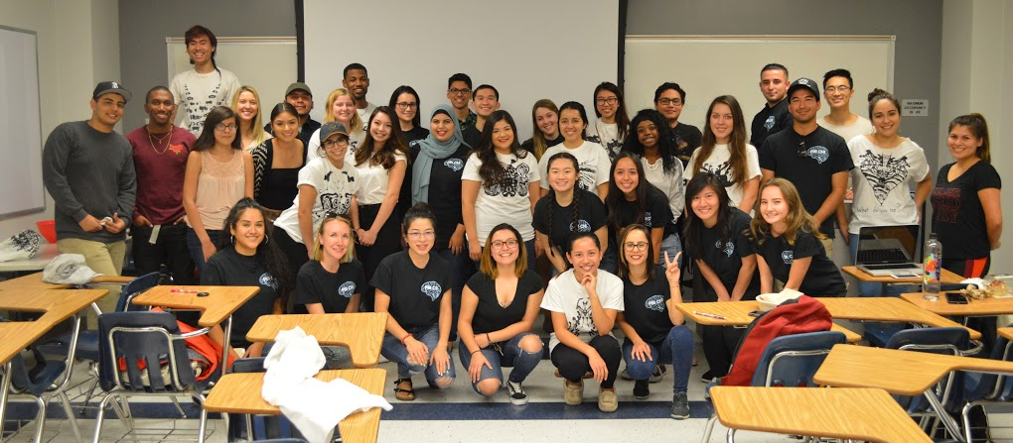
What is Psi Chi?
We are an open club for all students interested in Psychology.
Our mission is to encourage, stimulate, and maintain academic excellence for students in all fields, particularly in psychology. The international organization encourages members to contribute to the Psi Chi Journal, Eye on Psi Chi Magazine, and a new addition this month, PsychEverywhere Podcast!
Over 700,000 members including B.F. Skinner, Albert Bandura, and Florence L. Denmark.
Notes:
Bev

Slide 2
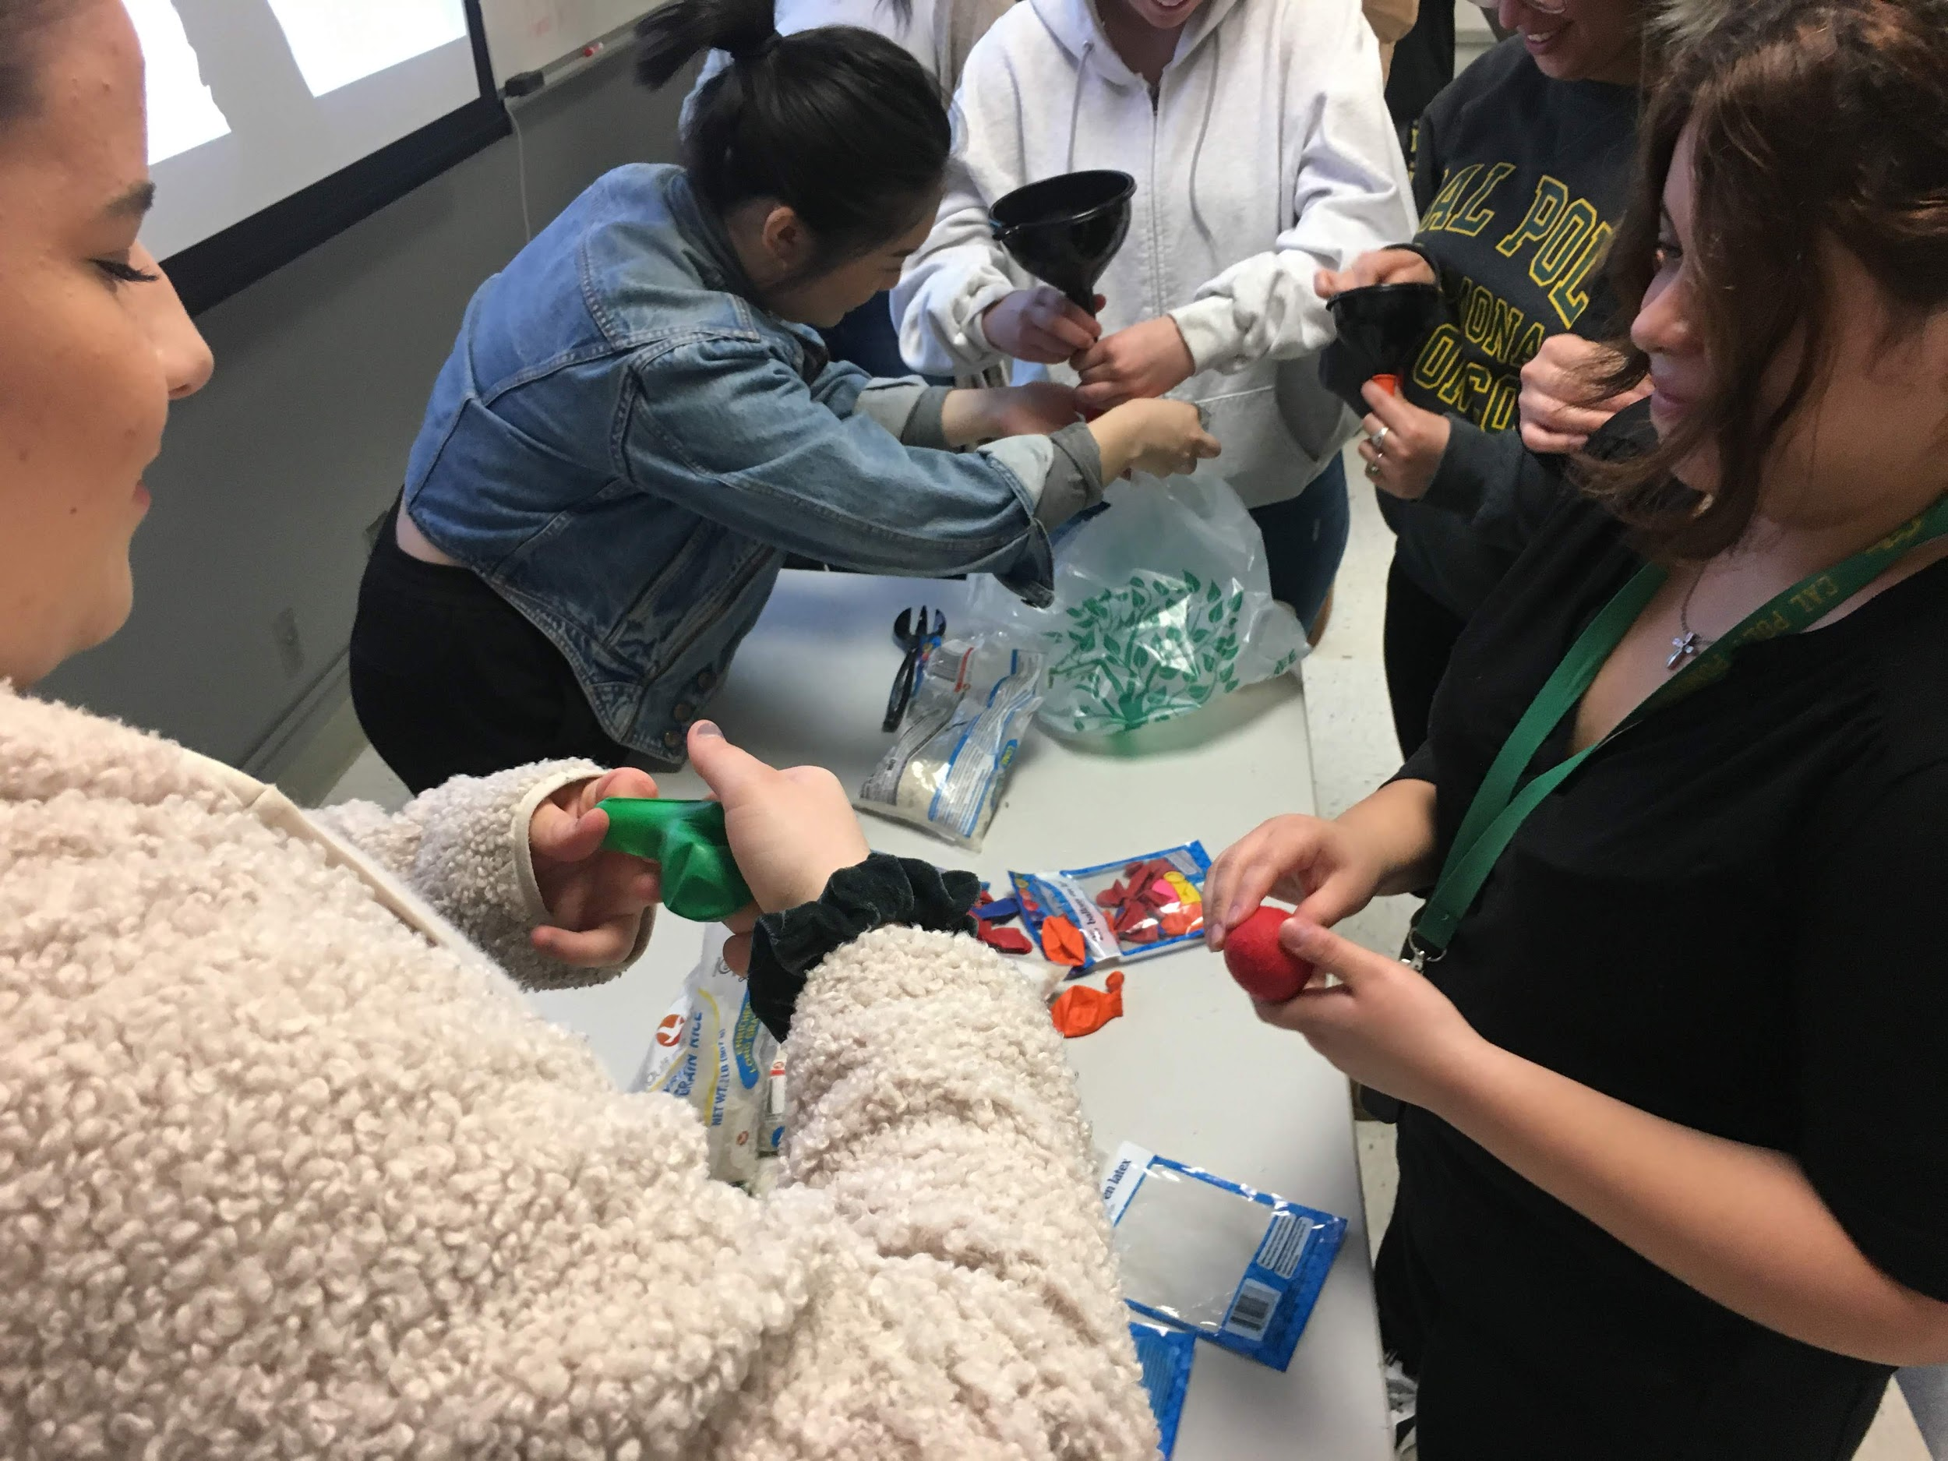
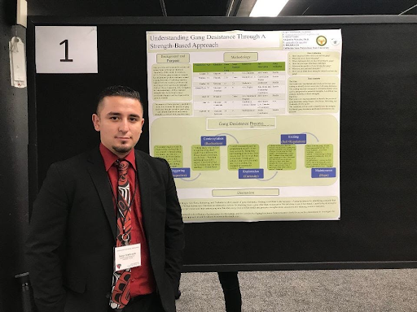
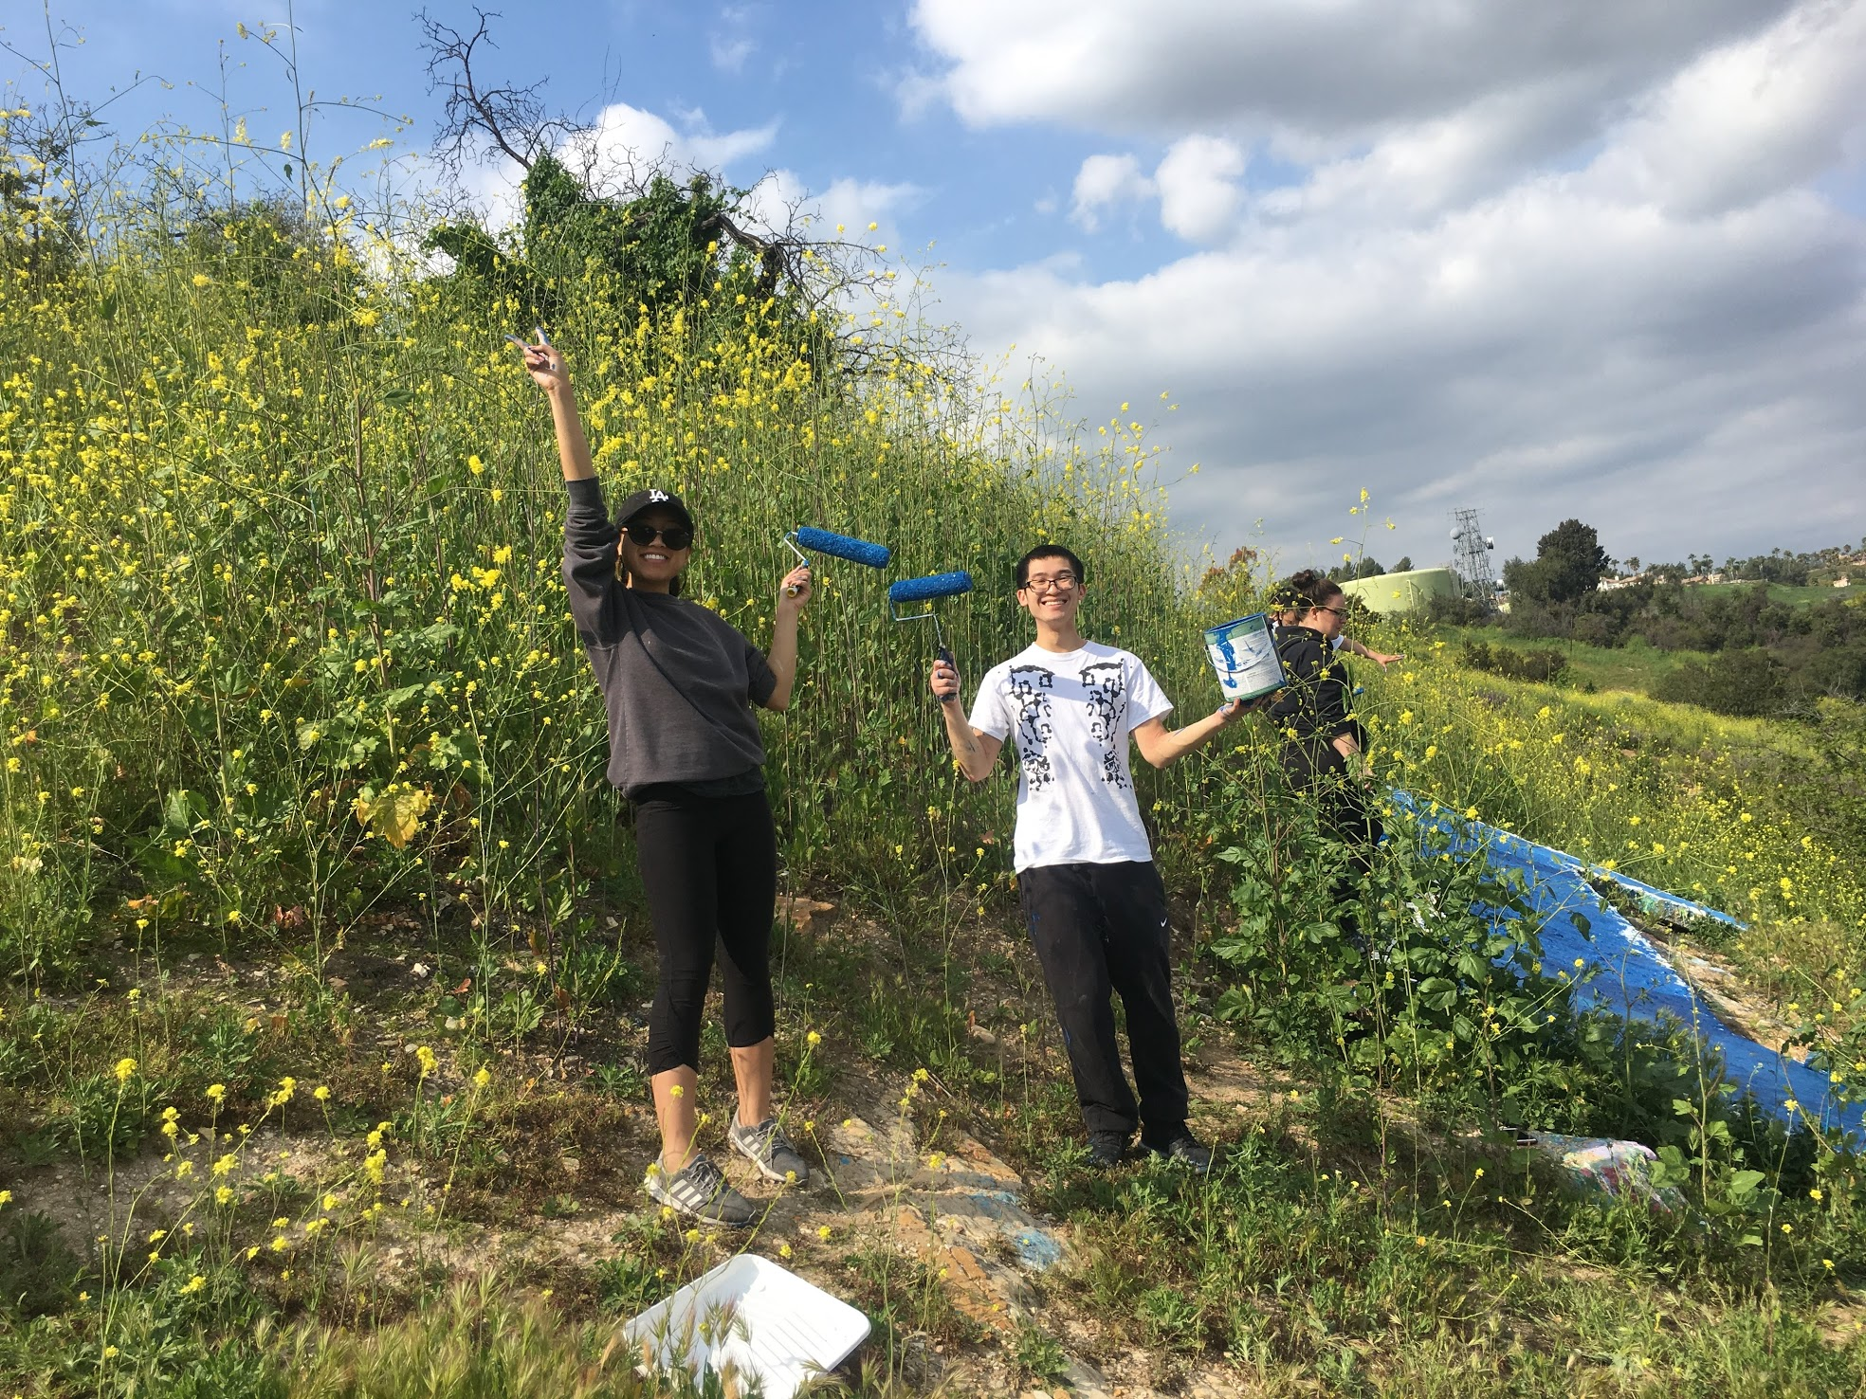
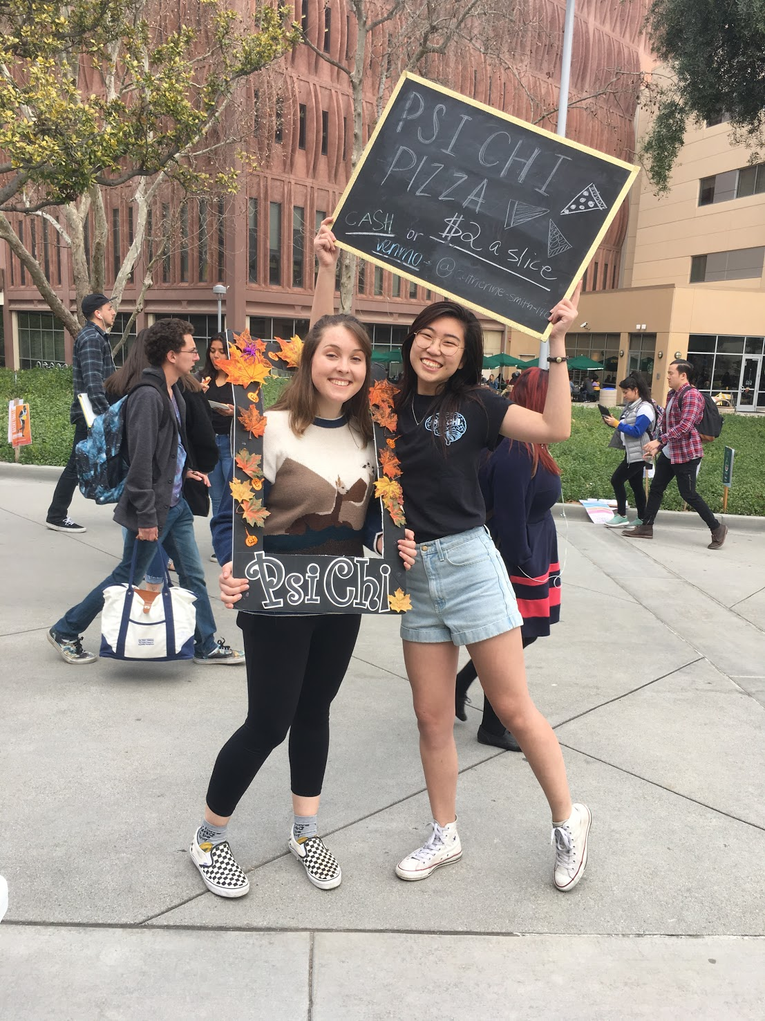
Benefits
You will learn about
Careers in psychology and related fields
How to get research/internship experience
Faculty talks and guest speakers
Graduation prep
Developing meaningful and professional relationships with other scholars
Notes:
Karli

Slide 3
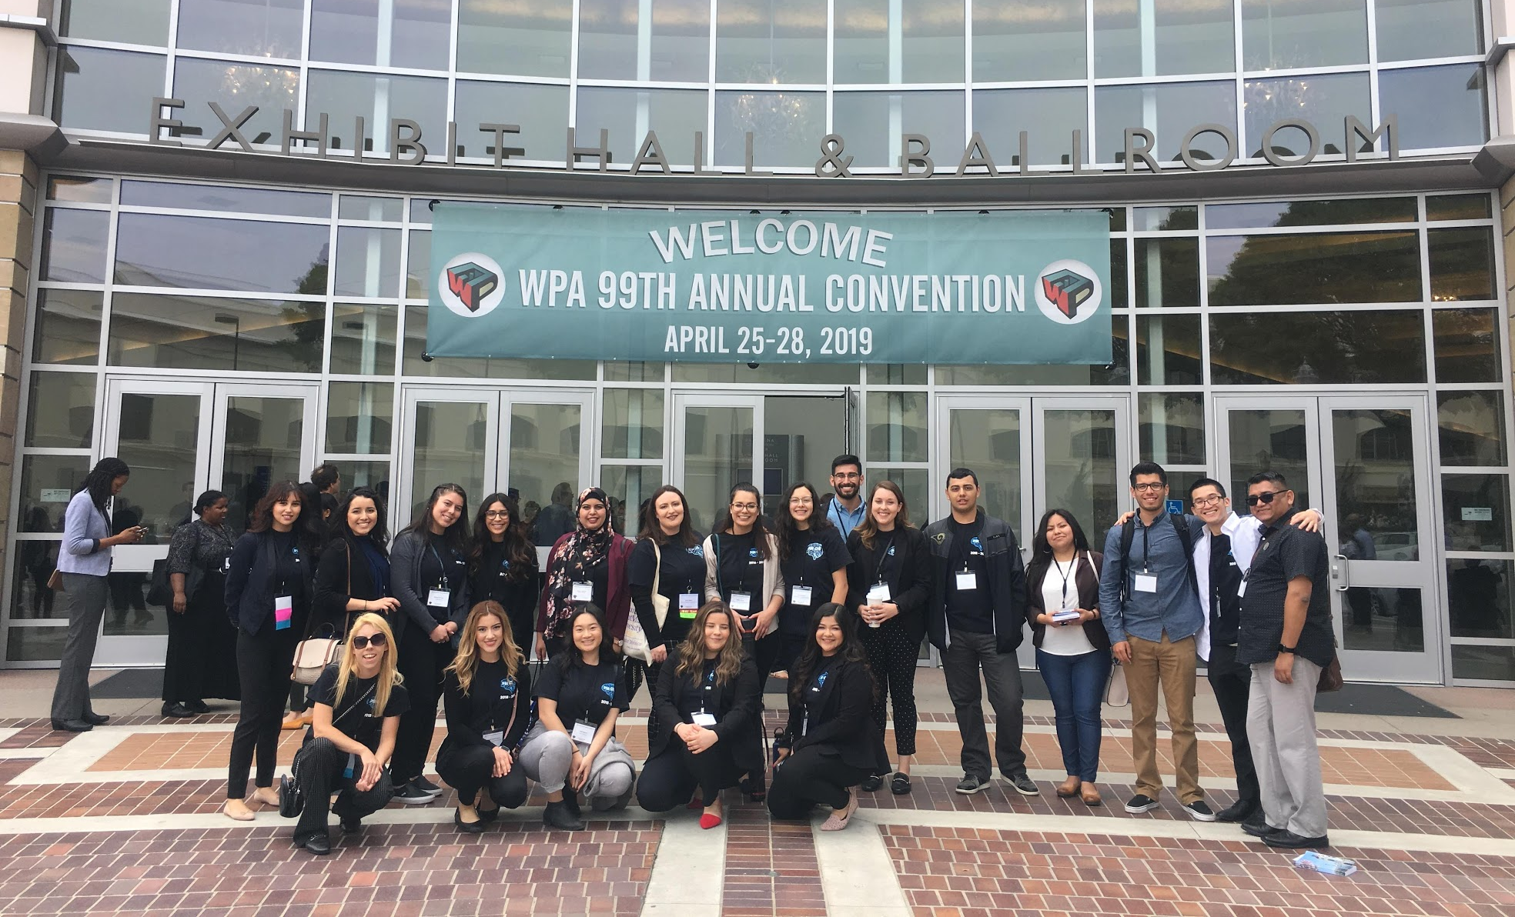
Brief on WPA
100th year @ San Francisco
Dates: April 30th - May 3, 2020
Attend talks from faculty, graduate students, and undergraduate students
Network with students and faculty outside of Cal Poly Pomona
Learn more about research and graduate schools
Fun fact: Hang out with CPP Psych Profs! :)
Notes:
Bev

Slide 4
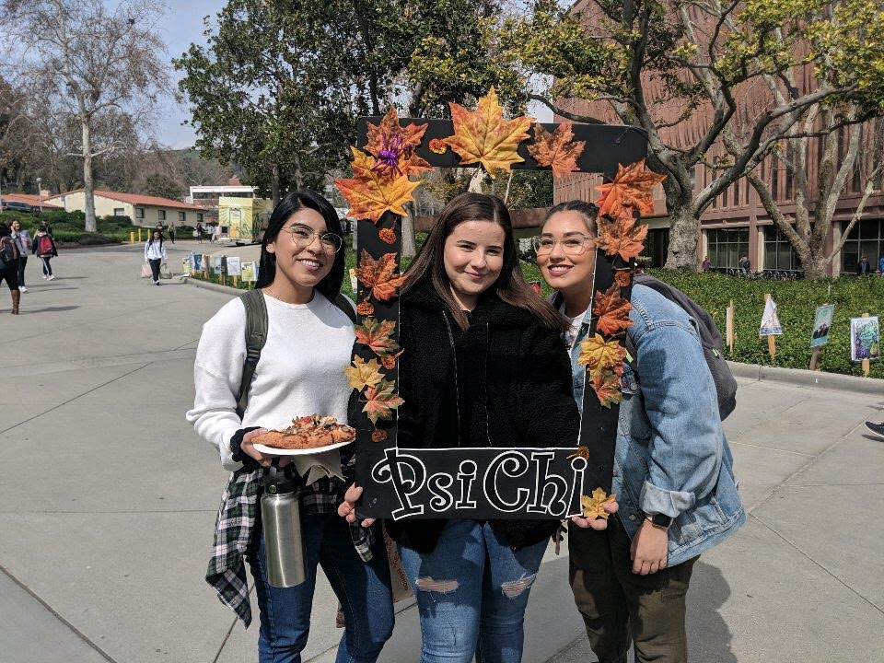
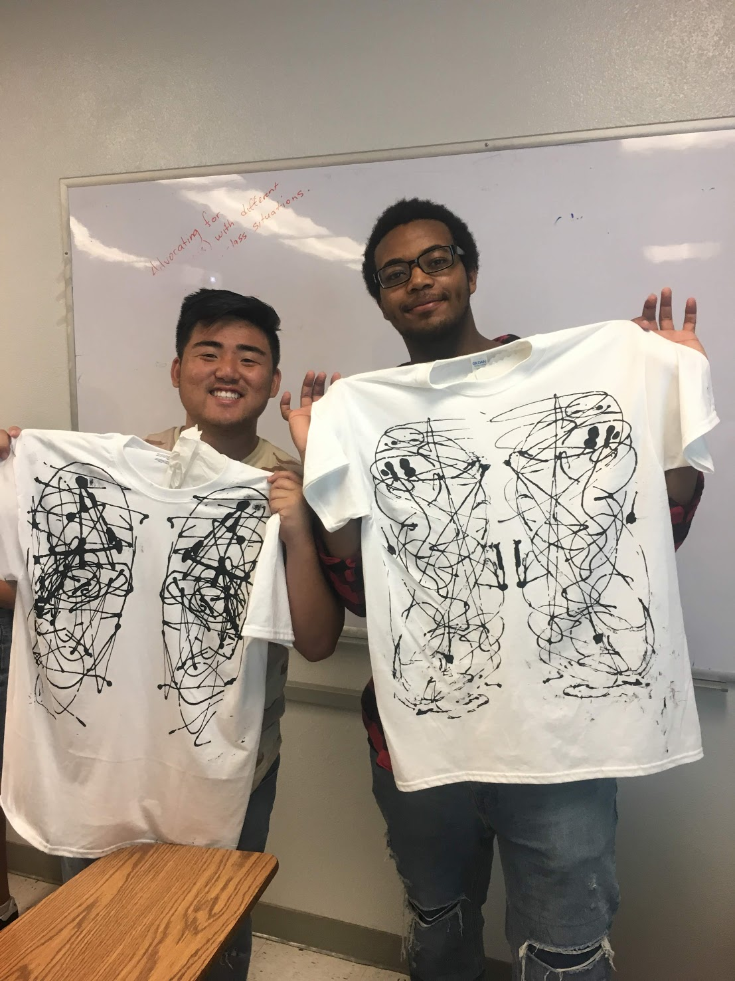
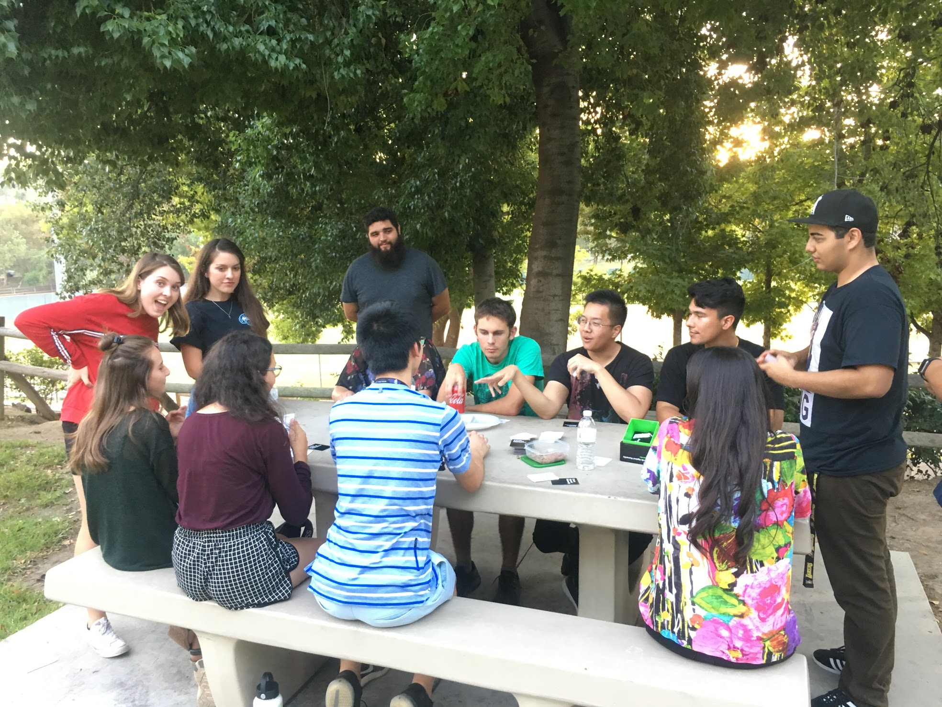
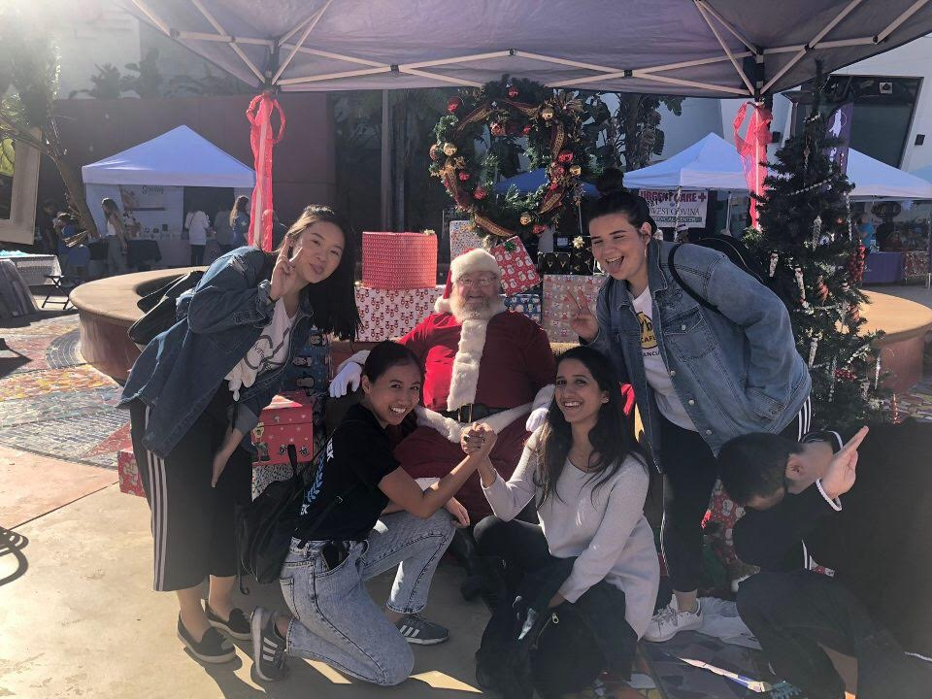
Chapter Membership
$40 for the year
$25 a semester
Official CPP chapter member
Eligible to vote/hold office
Membership points
No formal requirements! :)
Free Psi Chi T-Shirt (yearly dues)
Funding to attend WPA
Free Socials (TBA!)
**Deadline to pay: Tuesday, October 8th**
Notes:
Daniela?

Slide 5
Advisor
Dr. Alejandro Morales
E-mail: amorales2@cpp.edu
Office: Building 5, Room 231
Notes:
Bev

