Slide 2
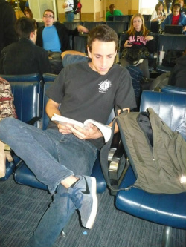
President: Sidney Widmark

Slide 3
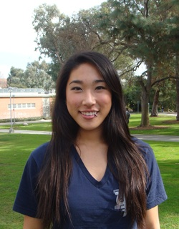
Vice President: Jessica Moon

Slide 4
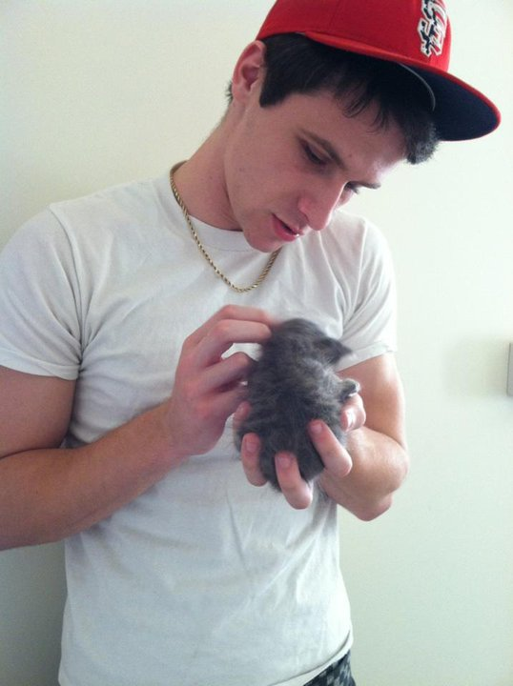
Secretary: Casey La Honta

Slide 5
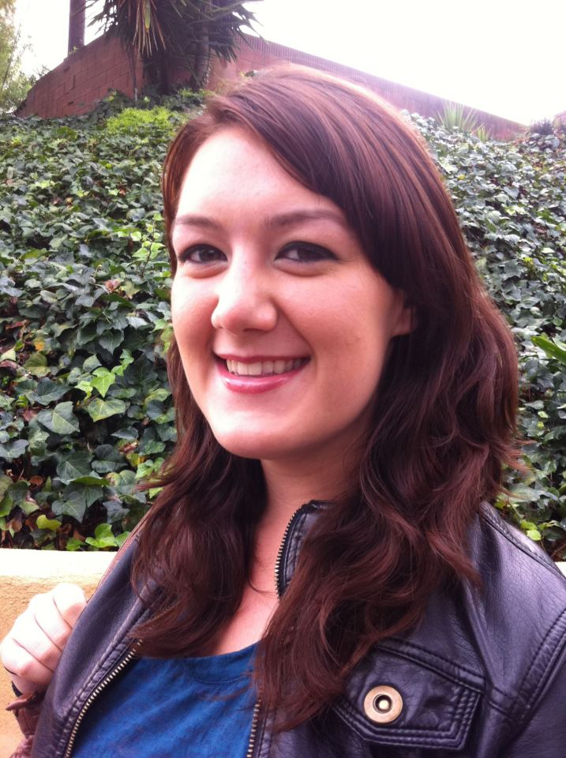
Treasurer: Elizabeth Shea

Slide 6
Fundraising: Lilian Saldaña

Slide 7
Community Service: Rose Herndier

Slide 8
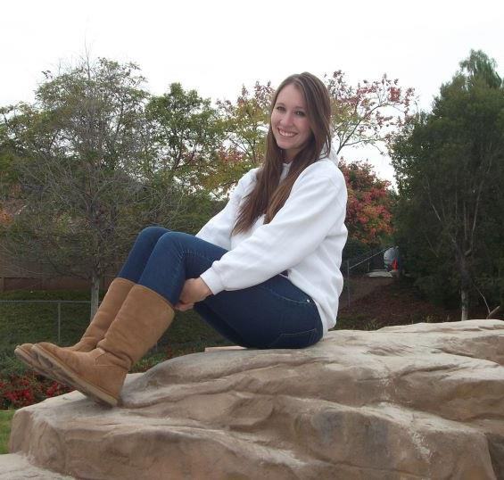
Historian/WPA: Kat Courtney

Slide 9
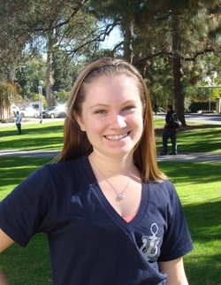
Public Relations: Rachelle Webb
A.K.A. Chelley!

Slide 10
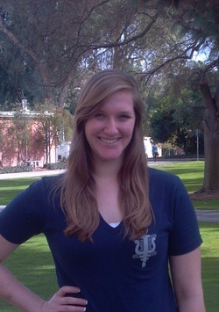
Social Chair: Jessica Smith

Slide 11
Class Council Rep: Adrian Calderon

Slide 12
Advisor: Dr. Bettina J. Casad

Slide 13
What is Psi Chi?
Psi Chi is an International Honor Society in Psychology, founded in 1929.
Psi Chi is the International Honor Society in Psychology, founded in 1929 for the purposes of encouraging, stimulating, and maintaining excellence in scholarship, and advancing the science of psychology.
Psi Chi is an affiliate of the American Psychological Association (APA) and the American Psychological Society (APS).
The Cal Poly Pomona Chapter - the largest organization in C.L.A.S.S.

Slide 14
What are chapter is dedicated to:
To provide an environment that promotes creative development.
Activities
Grad school student panel
Speakers and professor presentations
Research opportunities and information
Attendance and professional conferences, especially WPA
Social events
Welcome Back Socials
Bowling Nights
Drive-In Movies
Dodgeball
Community service events
Matt’s Run
KidCare
Outreach Nation
Fundraisers
T-Shirts
Bake sales
Chocolate Sales
Profit-Share Events

Slide 15
What are the benefits?
Professional growth
Community Service
Exposure to different fields of psychology.
Meeting and interacting with leaders in their field and other students interested in psychology.
Networking - References
Notification of research and job opportunities/ internships/ and scholarships.
Having fun!

Slide 16
Qualifications for International Membership
3.0 cumulative GPA
3.0 major class GPA
20 participation points
Meetings (1)
Social events (2)
Community Service (3)
Fundraisers (3)
Attending conferences (4)
Presenting at conferences (5)
Complete application for national membership by (November 30th for Fall quarter)
You DO NOT have to be a International member to participate.
For questions regarding past and future points, talk to Casey La Honta

Slide 17
Dues
How much?
$15.00 per quarter
$35.00 for the whole year (fall only)
What does it pay for?
Food/supplies
Speakers
Social events
Some costs towards WPA travel
Talk to this years Treasurer, Elizabeth Shea, about membership fees

Slide 18
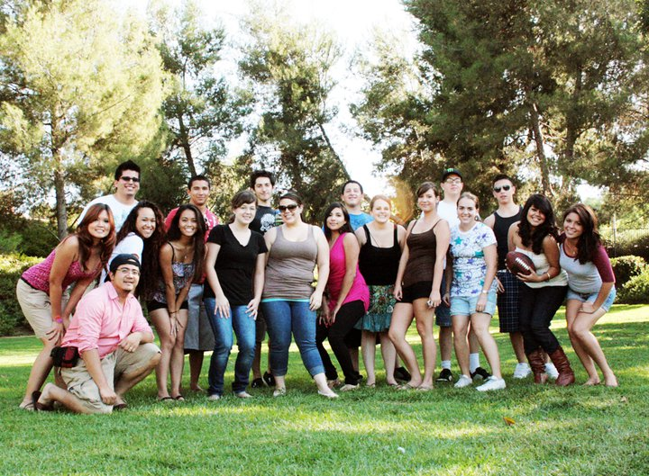
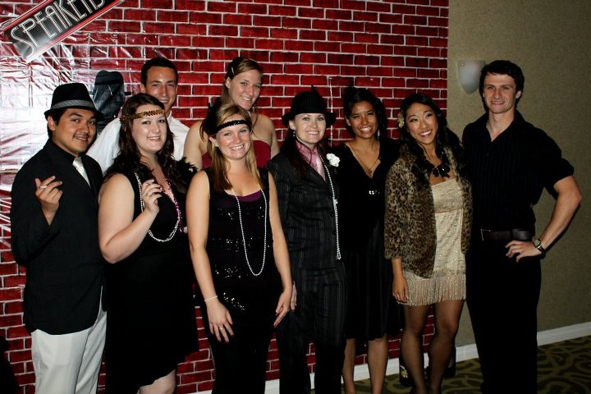
S O C I A L S

Slide 19
Winter Quarter Socials!!!
01-24-13
Thursday
8:30PM-Close
$2.00 Games
$2.00 Shoe rental
$1.00 Items
- Hot dog, Fries, Soda
$2.00 Items
- Nachos, Chili cheese dogs
02-06-13
Wednesday
Boomers Mini Golf/ Cosmic Mini Golf
$4.00 per game per person Any Age Requires 10 or more people booked 48 hours in advance.
Or $8.00 Per person per game without group
03-08-12
Friday
Mission Tiki Drive-In
Admission : $7 for adults and 1$ for ages 5-9
Week of will do a poll for which movie (s) we will see.
Other Events We are trying to plan:
-Disneyland Day
-Museum Trip
-Laser Tag
Have fun ideas? Please contact us!!!
We are here to plan fun events for you!

Slide 20
Conferences
A great way to network, present research, and a better way to get to know your fellow Psi Chi members ☺

Slide 21
Western Psychological Association
April 25-28, Reno, NV
http://www.westernpsych.org/convention/index.cfm

Slide 22
WPA Conference
Travel to an unfamiliar city & explore!
Attend the conference with Psi Chi members, enjoy the company of CPP professors & other professionals!
Present your data and represent Cal Poly Pomona
Hang out with your peers and professors outside of the classroom
Get pumped about Psi Chi & consider being on next years e-board!

Slide 23
Psi Chi Book Exchange at CPP
Facebook Group
“Like” us at www.facebook.com/PsiChiBookExchangeAtCpp
Post comments/pictures about books you’d like to
Borrow
Buy
Loan
Sell

Slide 25
Psi Chi Study Hours
Please complete this section of the survey so we can formulate an appropriate schedule for the majority of Psi Chi members ☺
Use Psi Chi e-board member and others for HELP
GRE study sessions to prepare you for grad school!
Endless brainstorming sessions

Slide 26
The Website
psichicpp.com, by Webmaster Rachelle Webb
Includes membership information and links to Psi Chi International website
Resources for the club, club events, professional conferences, and on- and off-campus opportunities
Take the Psi Chi survey!

